Slide 1
Eindpresentatie 22 juni Student-medewerkers
Programma
Opening
Apolline & Bram
Pepijn & Lucas
Odilia & Charlotte
Samenvatting en vieren!
Naborrel
Notes:
Lets take you trough the program of this workshop.
First, we will tell you in short what OO ‘sH is, and what we do in this city.
After that, we will talk about the Social Design Circle. A way of thinking, wich helpes us transform Education into a more open structure.
Goal of the workshop is: To show you a way how to transform your education system/lesson/program/project into entrepreneurial learning.
SOOOL : the words have no meaning in English ;-) But this is what it comes down to: An education environment that is more social, more open, where students can learn in a exploring, researching and a designing manner.

Slide 2
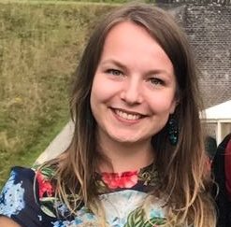
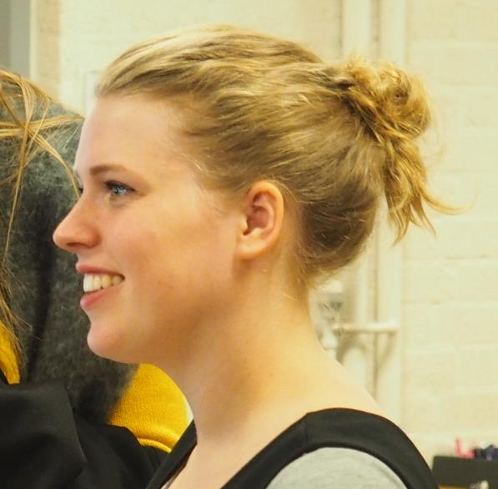
Wie zijn wij?
Bram van Eijndhoven
Journalistiek
Pepijn Giesbers
Social studies
Odilia Kerkhoven
Business innovation
Apolline Mol
Basisonderwijs
Lucas Artist
Bonafideel, gratis hulp
Charlotte Lubbes
Basisonderwijs
Notes:
Let’s introduce ourselves!
(een iemand even kort aanwijzen wie er aanweig zijn in het lokaal)

Slide 3
Apolline
Notes:
Lets take you trough the program of this workshop.
First, we will tell you in short what OO ‘sH is, and what we do in this city.
After that, we will talk about the Social Design Circle. A way of thinking, wich helpes us transform Education into a more open structure.
Goal of the workshop is: To show you a way how to transform your education system/lesson/program/project into entrepreneurial learning.
SOOOL : the words have no meaning in English ;-) But this is what it comes down to: An education environment that is more social, more open, where students can learn in a exploring, researching and a designing manner.

Slide 4
Bram
Notes:
Lets take you trough the program of this workshop.
First, we will tell you in short what OO ‘sH is, and what we do in this city.
After that, we will talk about the Social Design Circle. A way of thinking, wich helpes us transform Education into a more open structure.
Goal of the workshop is: To show you a way how to transform your education system/lesson/program/project into entrepreneurial learning.
SOOOL : the words have no meaning in English ;-) But this is what it comes down to: An education environment that is more social, more open, where students can learn in a exploring, researching and a designing manner.

Slide 5
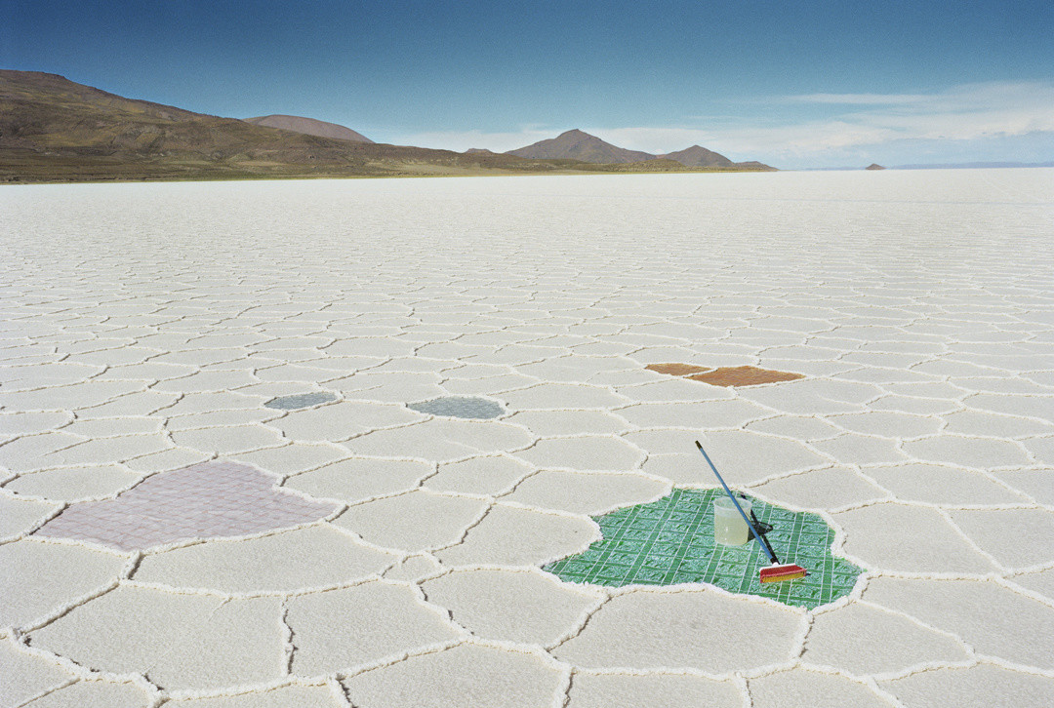
Kijk op onderwijs
Werkzaamheden
Transfer
Ervaringen
Notes:
In the case of Yvvy:
What is important to pay attention to when you work for a Travel Agency?
An expert from a real Travel Agency came in the classroom, and explained how this job works. What you do, what you pay attention to etc.
Students interviewed their teachers about their dream holiday. (They came up with questions, they practiced in interviewing, and gain insights in someone elses interests when it comes to a perfect holiday. They asked: what kind of journey is it going to be? Relaxing at the beach? Or more adventurous?
Students put together a dream holiday for their teacher. A specific country, researching the culture, the citiys you come across, the nature, the wheater, the language etc.
They also practiced with budget: what would this holiday cost? What is the teacher prepared to spend? What are the costs for the plane, transportation and a hotel for example?

Slide 6
Transfer & afspraken

Slide 7
Pepijn
Notes:
Lets take you trough the program of this workshop.
First, we will tell you in short what OO ‘sH is, and what we do in this city.
After that, we will talk about the Social Design Circle. A way of thinking, wich helpes us transform Education into a more open structure.
Goal of the workshop is: To show you a way how to transform your education system/lesson/program/project into entrepreneurial learning.
SOOOL : the words have no meaning in English ;-) But this is what it comes down to: An education environment that is more social, more open, where students can learn in a exploring, researching and a designing manner.

Slide 8
Lucas
Notes:
Lets take you trough the program of this workshop.
First, we will tell you in short what OO ‘sH is, and what we do in this city.
After that, we will talk about the Social Design Circle. A way of thinking, wich helpes us transform Education into a more open structure.
Goal of the workshop is: To show you a way how to transform your education system/lesson/program/project into entrepreneurial learning.
SOOOL : the words have no meaning in English ;-) But this is what it comes down to: An education environment that is more social, more open, where students can learn in a exploring, researching and a designing manner.

Slide 9
Transfer & afspraken

Slide 10
Odilia
Notes:
Lets take you trough the program of this workshop.
First, we will tell you in short what OO ‘sH is, and what we do in this city.
After that, we will talk about the Social Design Circle. A way of thinking, wich helpes us transform Education into a more open structure.
Goal of the workshop is: To show you a way how to transform your education system/lesson/program/project into entrepreneurial learning.
SOOOL : the words have no meaning in English ;-) But this is what it comes down to: An education environment that is more social, more open, where students can learn in a exploring, researching and a designing manner.

Slide 11
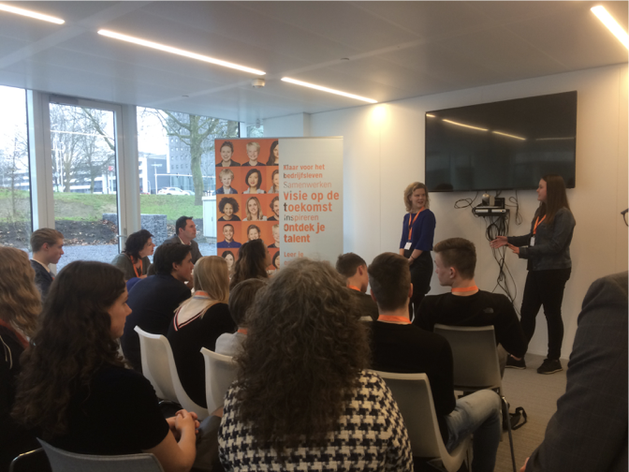
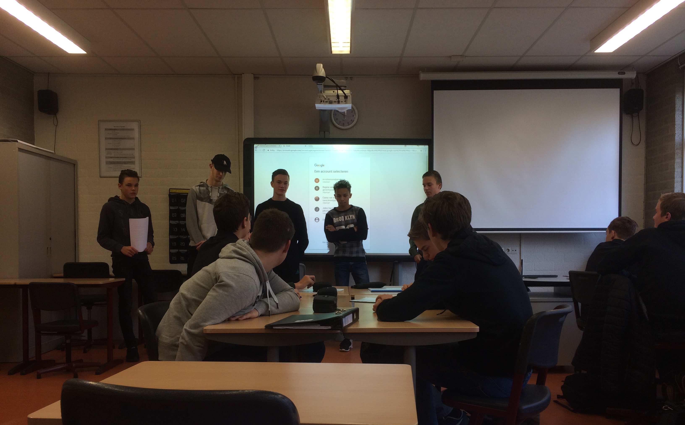
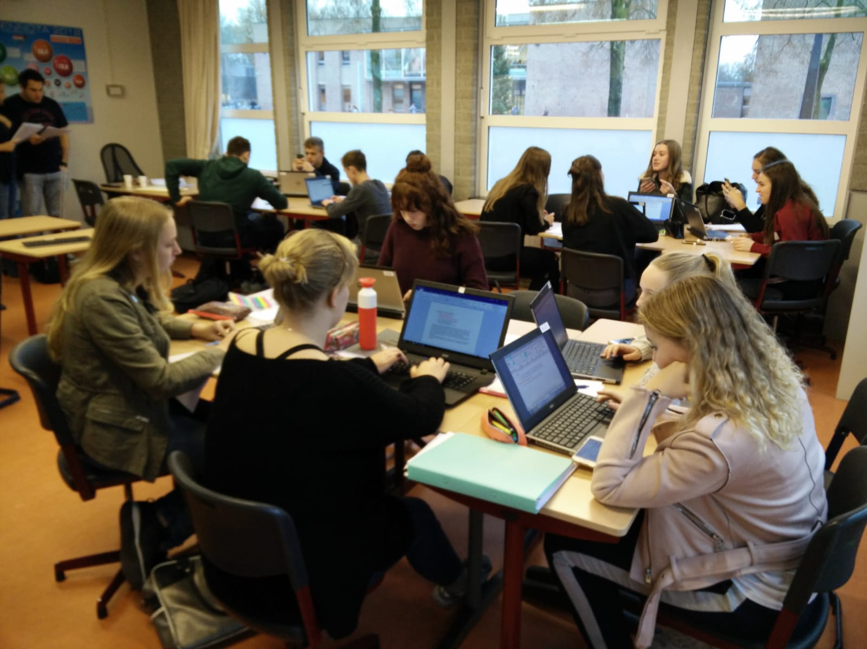
Jong Ondernemen

Slide 12
RUIMTE VOOR ONDERNEMENDHEID
ONTWERKPCIRKEL
GROWTH MINDSET
DOORLOPENDE LEERLIJN

Slide 13
Charlotte
Notes:
Lets take you trough the program of this workshop.
First, we will tell you in short what OO ‘sH is, and what we do in this city.
After that, we will talk about the Social Design Circle. A way of thinking, wich helpes us transform Education into a more open structure.
Goal of the workshop is: To show you a way how to transform your education system/lesson/program/project into entrepreneurial learning.
SOOOL : the words have no meaning in English ;-) But this is what it comes down to: An education environment that is more social, more open, where students can learn in a exploring, researching and a designing manner.

Slide 14
Wat je geeft, krijg je terug.
Ondernemend Onderwijs als katalysator
Onderzoekend & ontwerpend leren, schoolplein van de toekomst
Personalized learning: het goede voorbeeld geven
Buitenschool, echt natuurlijk leren
Notes:
In the case of Ivvy:
Students presented their teachers dream holiday, to the teachers themselves. This was also the the examenation of the project.
Results where: Verry Verry enthousiastic students. Up untill now, they want to know if the teachers actually went on their trip. Teachers had a very rich insight in the qualities en skills of their students, because they asked diffrent questions then they normally would.
This school has, after the very positive result, decided to transform more lessons themselves, using the same process from the Social Design Circle. They tackle the lessons that are not working, and they improve the ones that do.
The nest step would be to bring these experiences and innovations outside of the school walls. To make the transfer outside. Also cooperating with Organisations, or initiatives from outside the school will be very important. That way, students can work on real projects, that have meaning to society.

Slide 15
Transfer & afspraken

Slide 16
Vieren!
Samenvatting, felicitaties en bedankjes en toast op de student-medewerkers
Notes:
/// dit kan eventueel overgeslagen worden
2 keer 30 seconden!
And now: introduce yourselves! It is good to know who you’re sitting next to. Who knows, you might learn something from each other today…

Slide 17
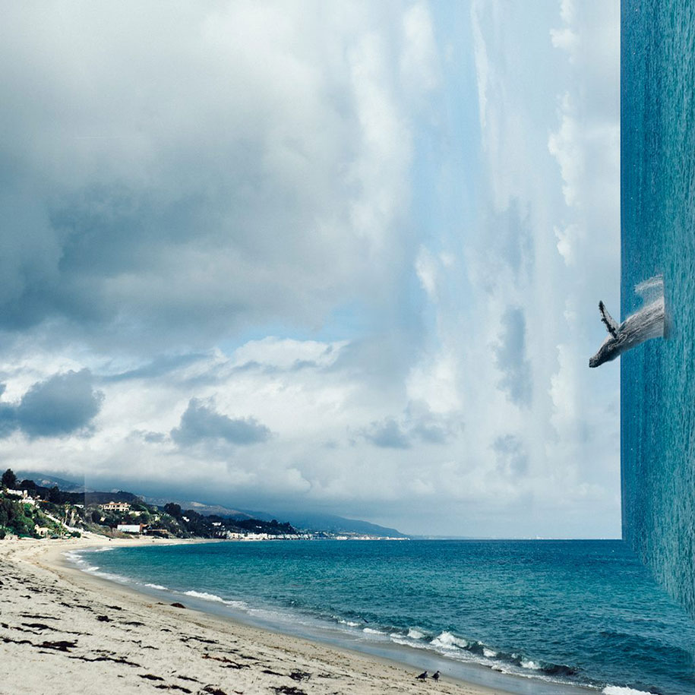
Napraten, netwerken, nagenieten

